Slide 1


Slide 2

Legislative Influence Detector
Sunlight Foundation
Notes:
State laws are not as unique as you may think. Often legislators copy bills from other states or from bills drafted by interest groups. For the past 14 weeks, we have been working with the sunlight foundation to build a tool to detect in real time where state legislators take text from.

Slide 3
State laws matter
states spend more than $1.5 trillion on programs and services
pass 75 times more bills than Congress

Slide 4
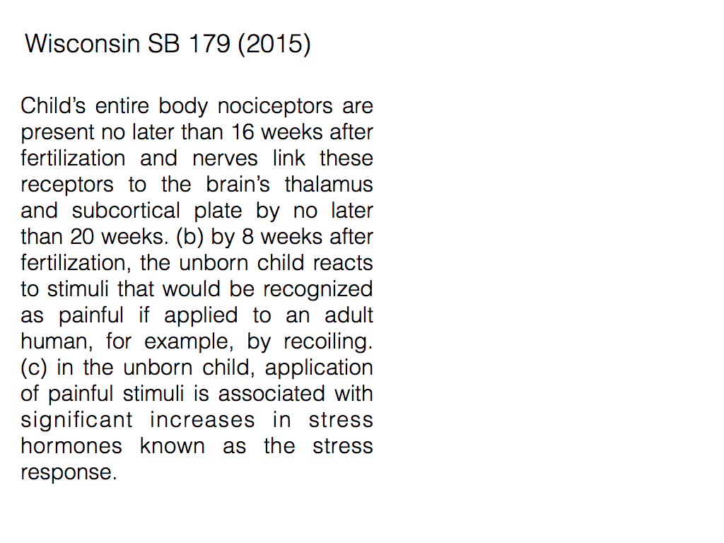
Notes:
A month ago, Wisconsin passed a bill limiting abortion rights. Journalists immediately observed that it was similar to other bills. In fact, many bilsl contained the exact same passages.

Slide 5
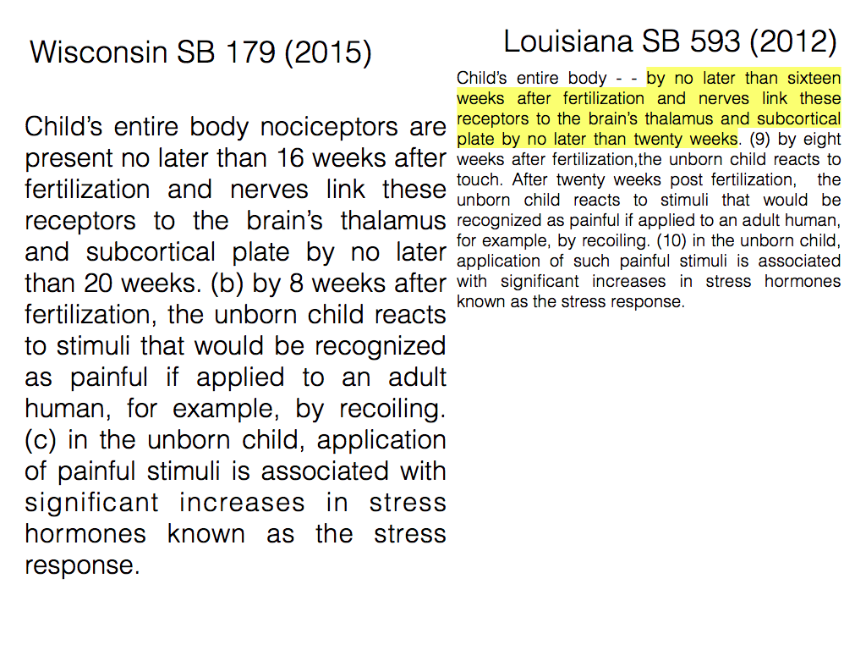
Notes:
The highlighted text in this Louisiana bill also appears in the Wisconsin bill.

Slide 6
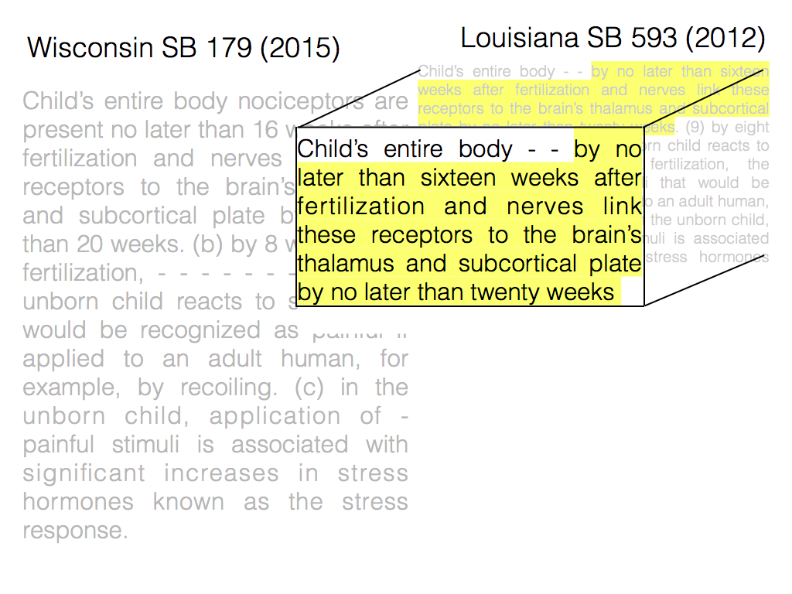

Slide 7
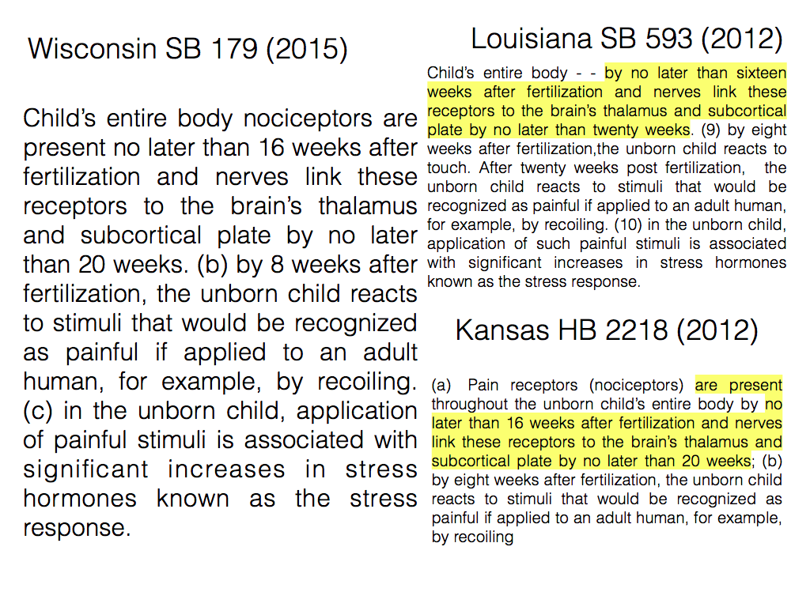
Notes:
Similarly, the highlighted text in this kansas bill also appears in the wisconsin bill

Slide 8
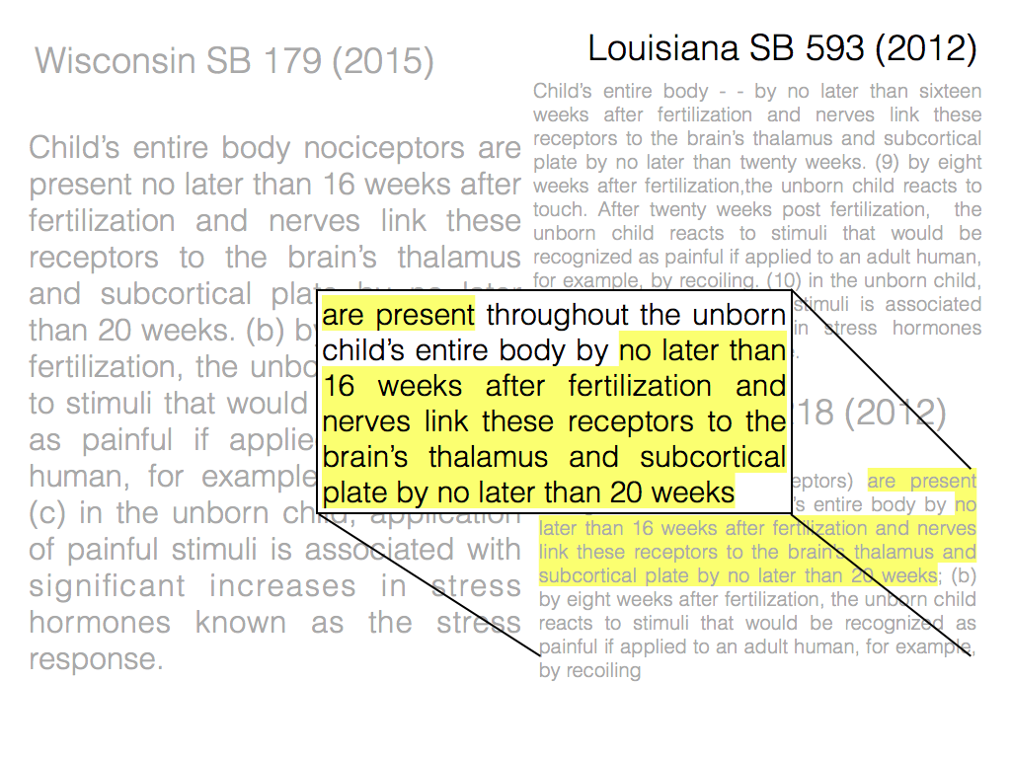
Notes:
Similarly, Kansas had very similar language. To find this shared text, journalists must perform the laborious task of googling passages from Wisconsin, reading through documents and finding shared text.
Copying text in this way is extremely common because legislators lack time, expertise, and staff to write their own bills. However, Finding these similar bills can be a laborious process. It requires using a search engine such as google and reading manually through the bills.

Slide 9
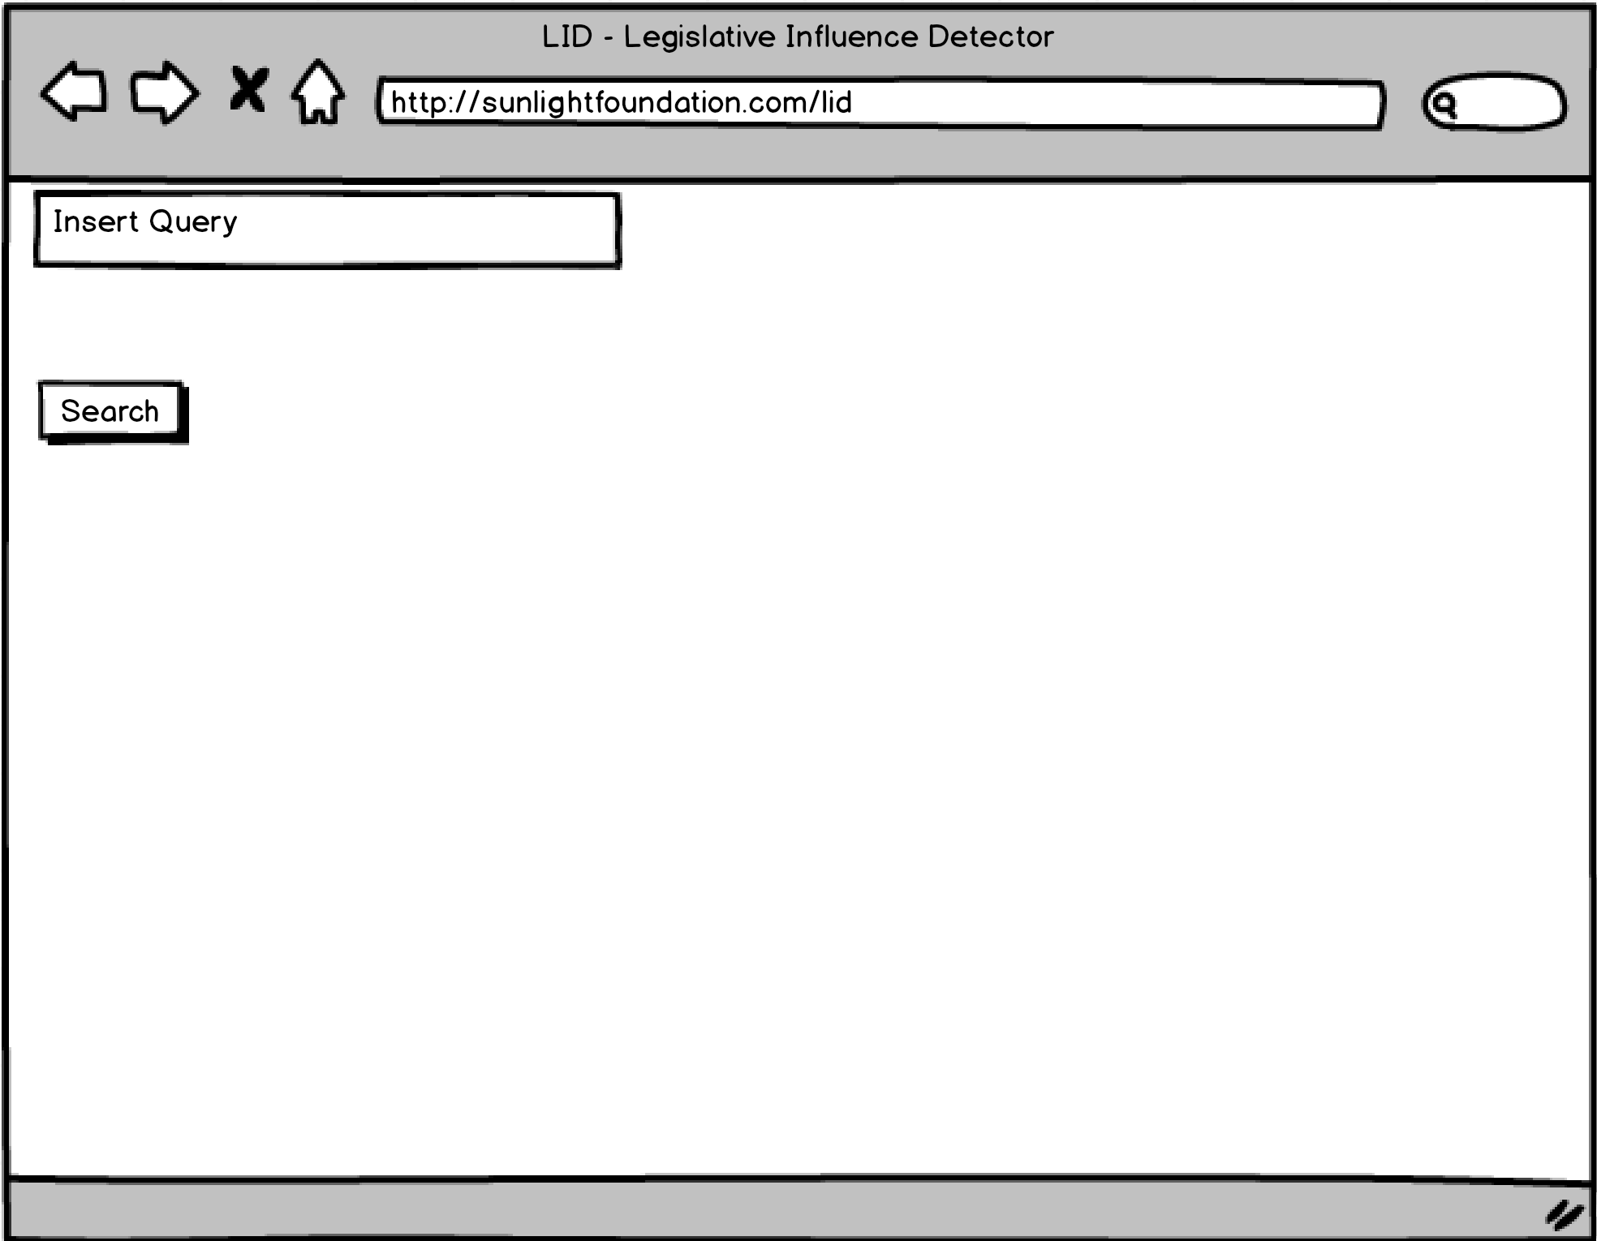
Notes:
Our tool--the legislative influence detector, or LID for short--automates the process of finding shared text by using text mining and machne learning algorithms. LID works as follows.

Slide 10
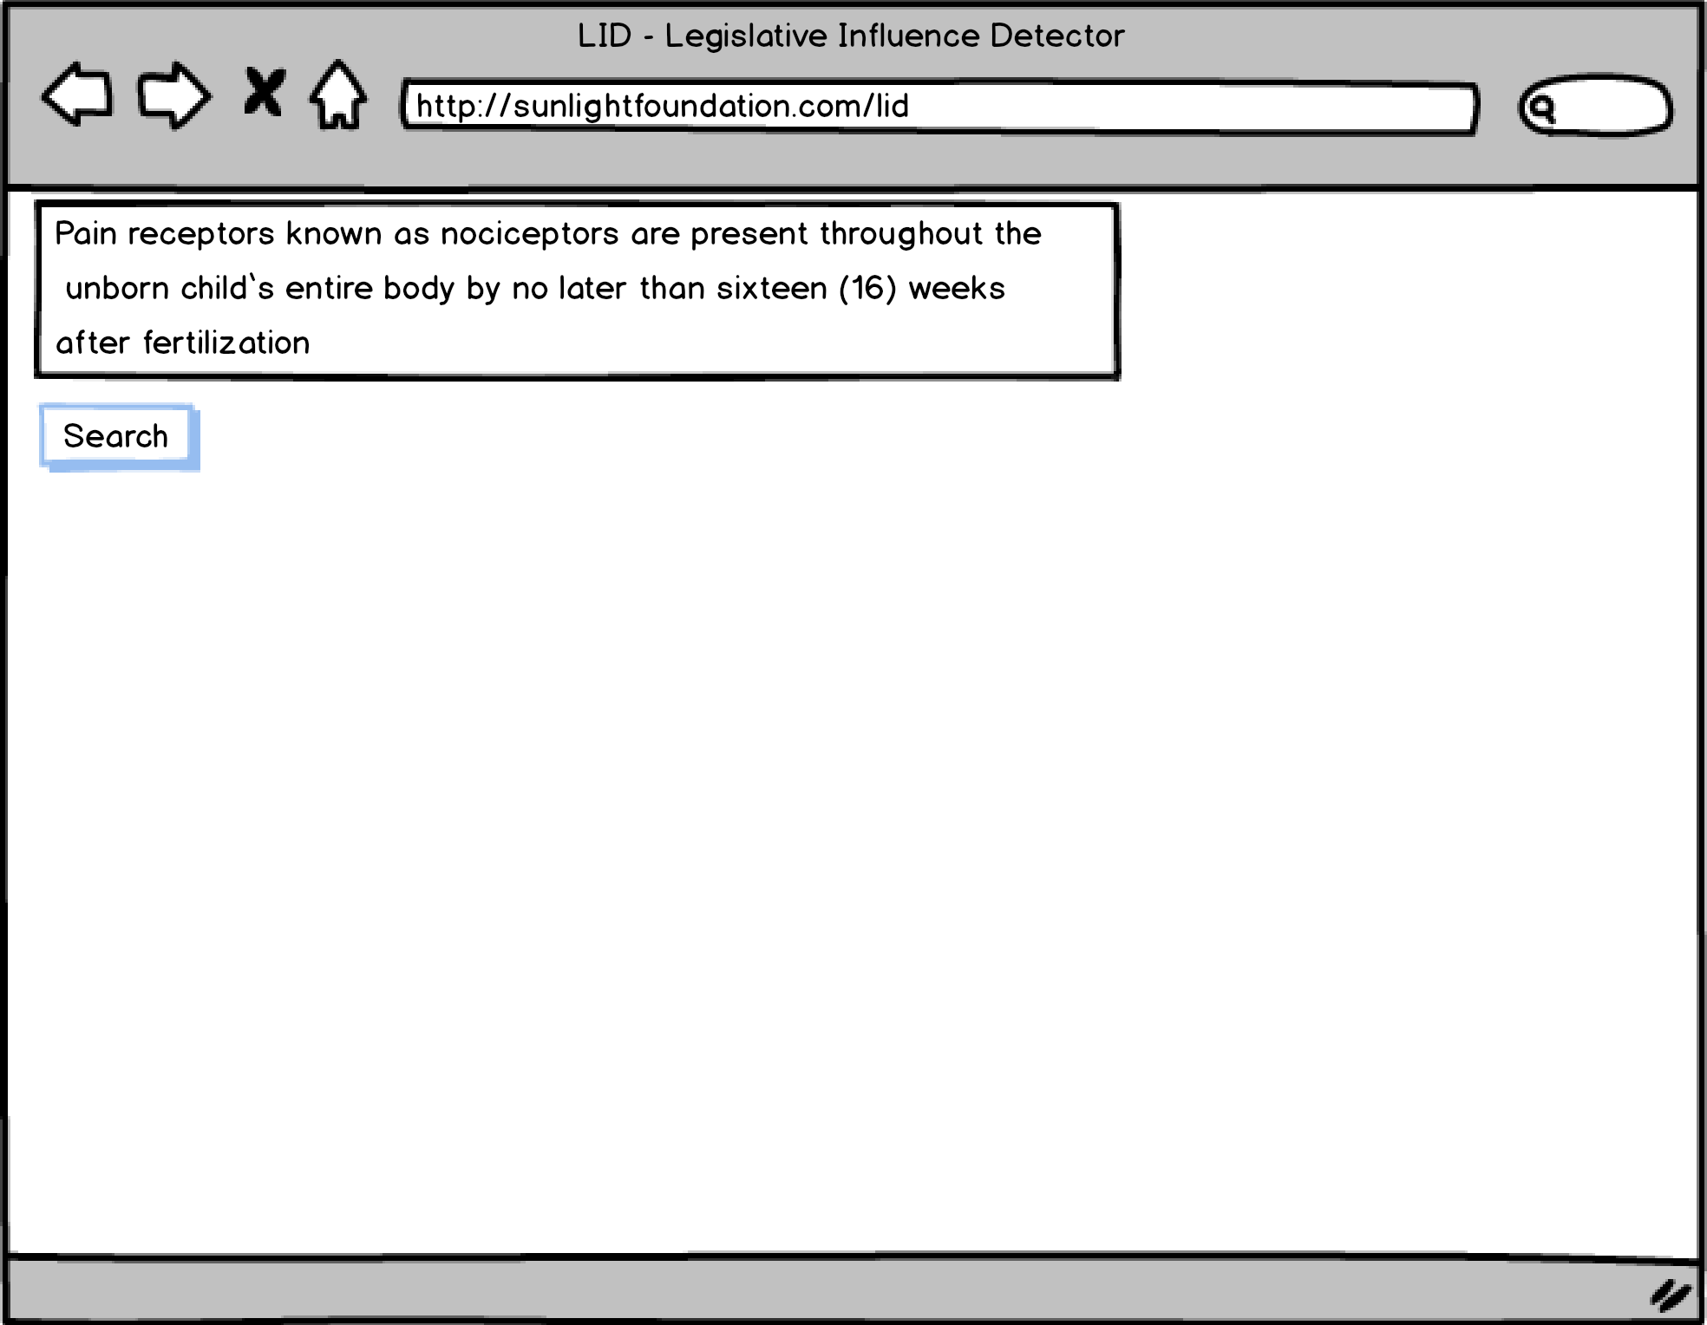
Notes:
The user inserts a portion of a query bill into the system.

Slide 11
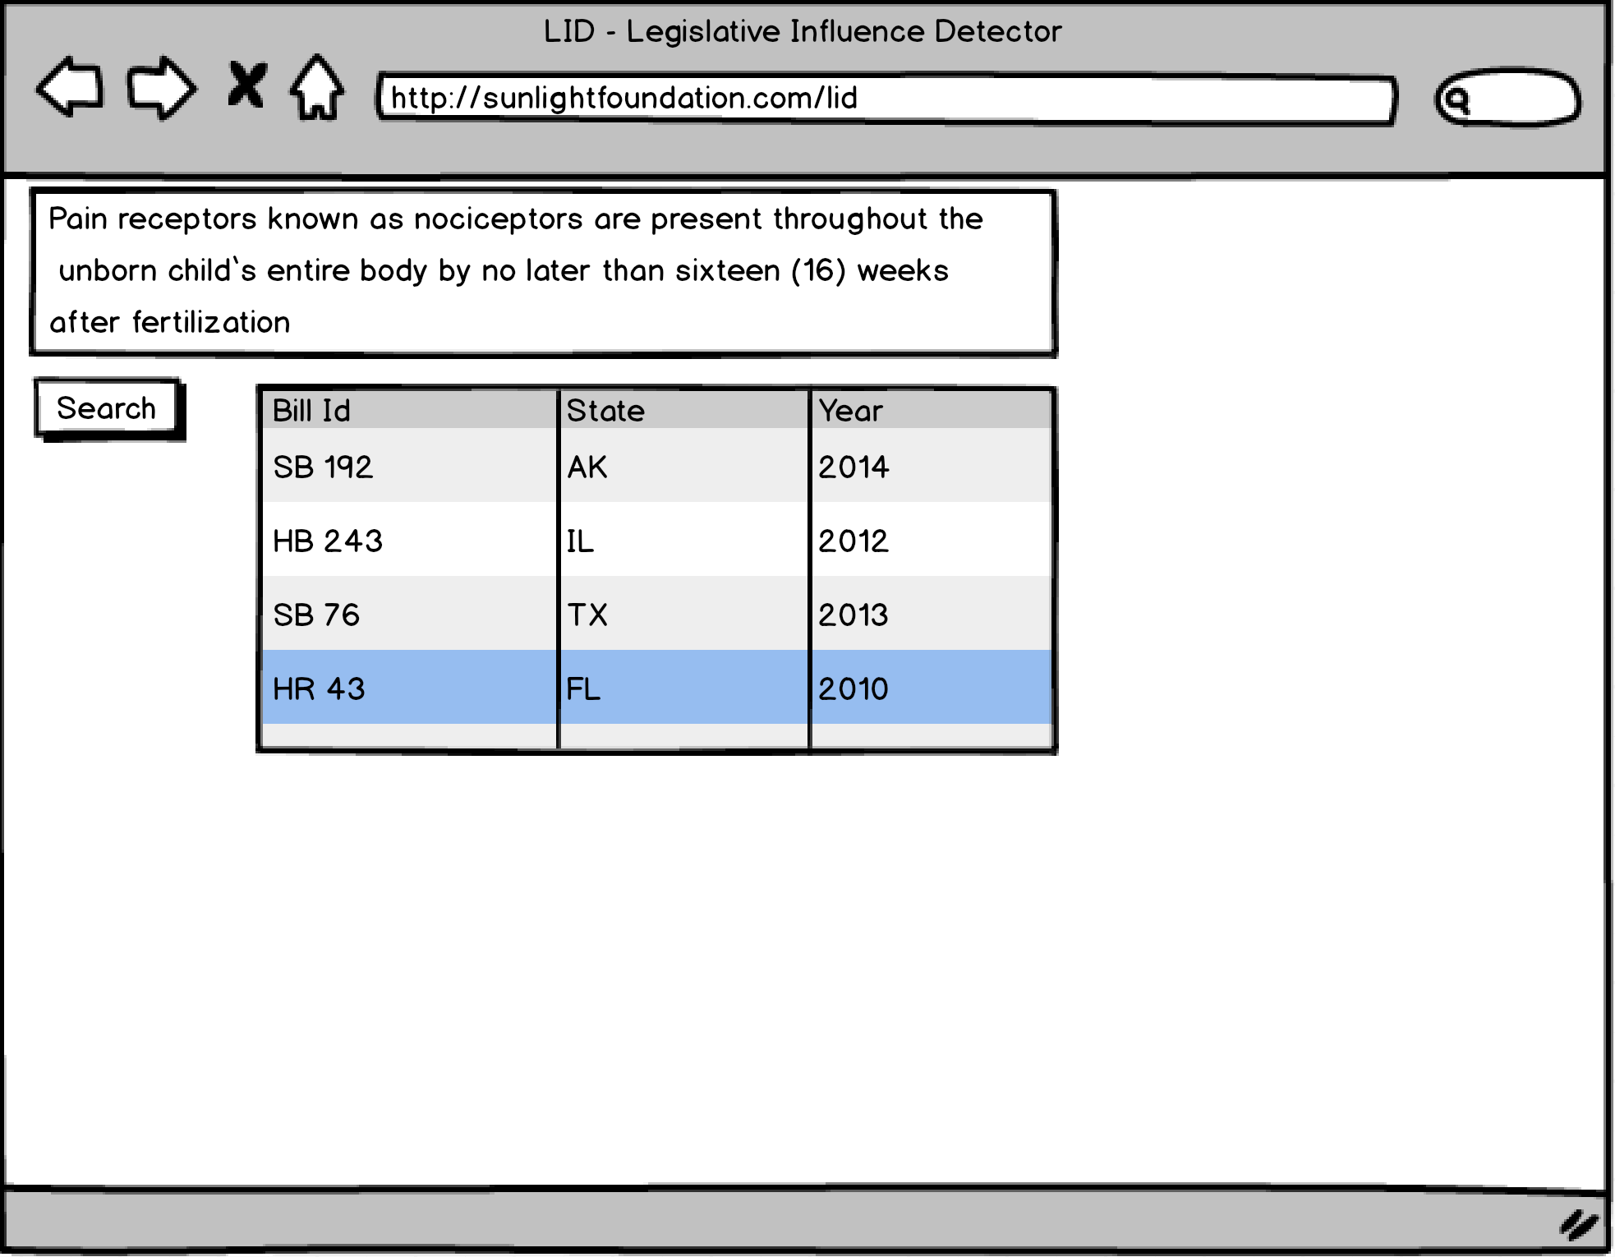
Notes:
LID then outputs a list of candidate bills that are likely to have shared text.

Slide 12
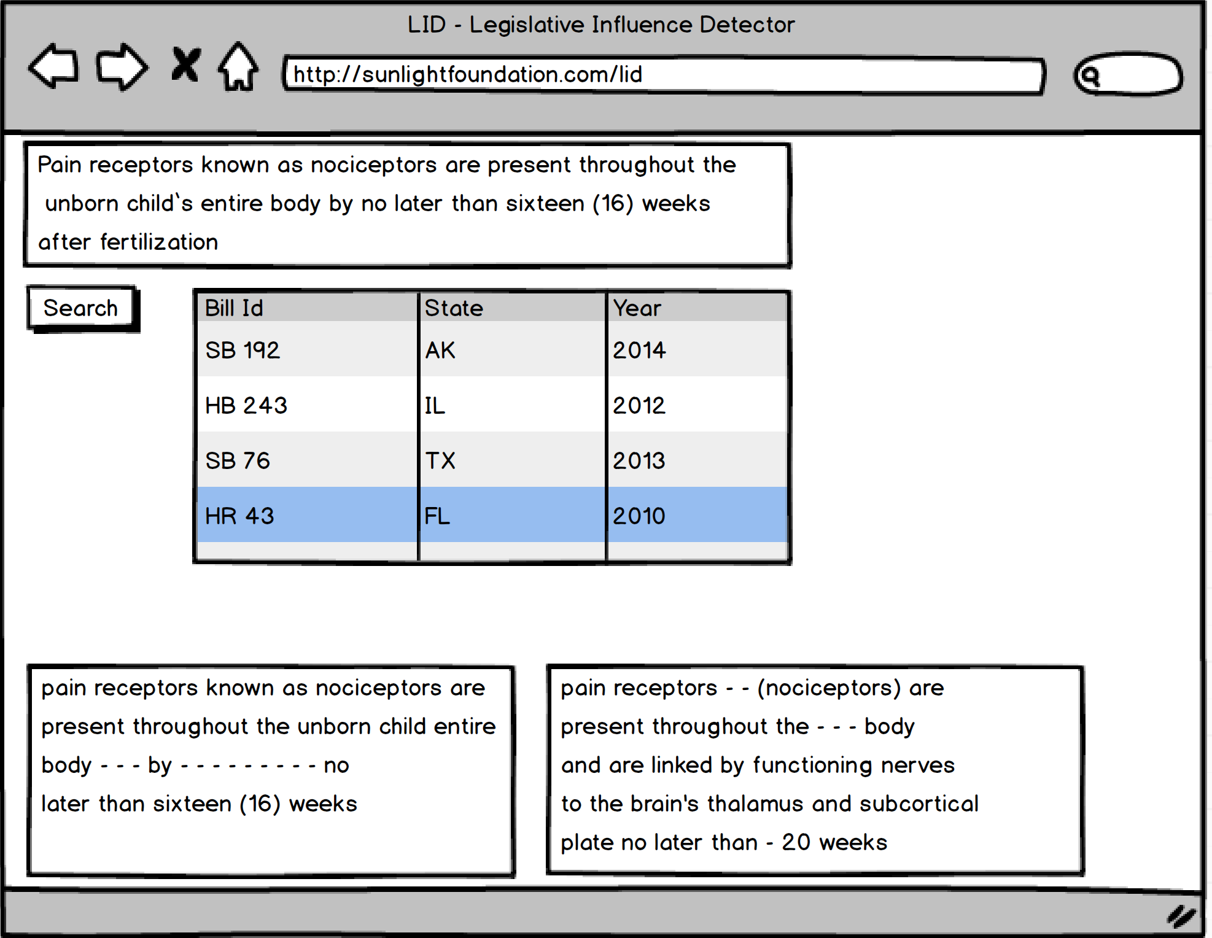
Notes:
The user then clicks on one of the candidate bills and LID shows the shared text between the two documents. To do this last step, it uses an algorithm from bioinformatics for finding similar regions in DNA sequences.

Slide 13
Notes:
To test the usefulness of our system, we inserted the text from the Wisconsin bill. We quickly found matches between (say the names of the states slowly).

Slide 14
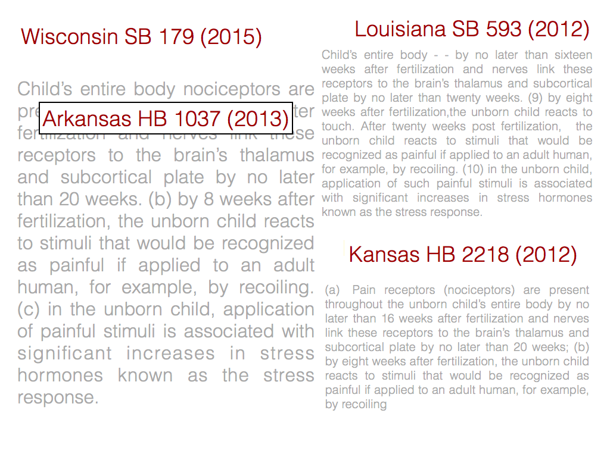

Slide 15
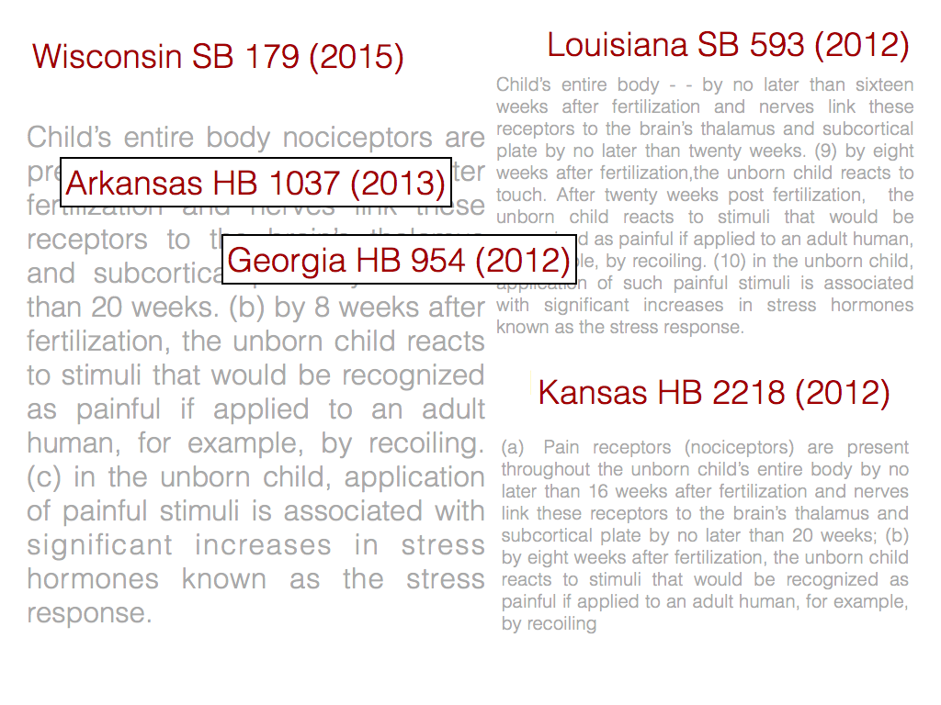

Slide 16
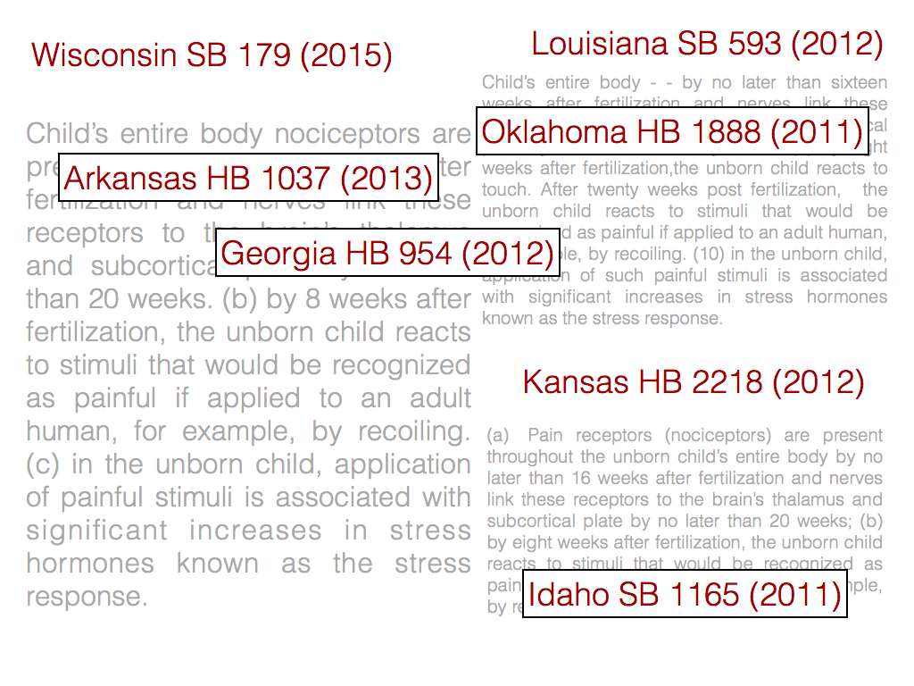

Slide 17
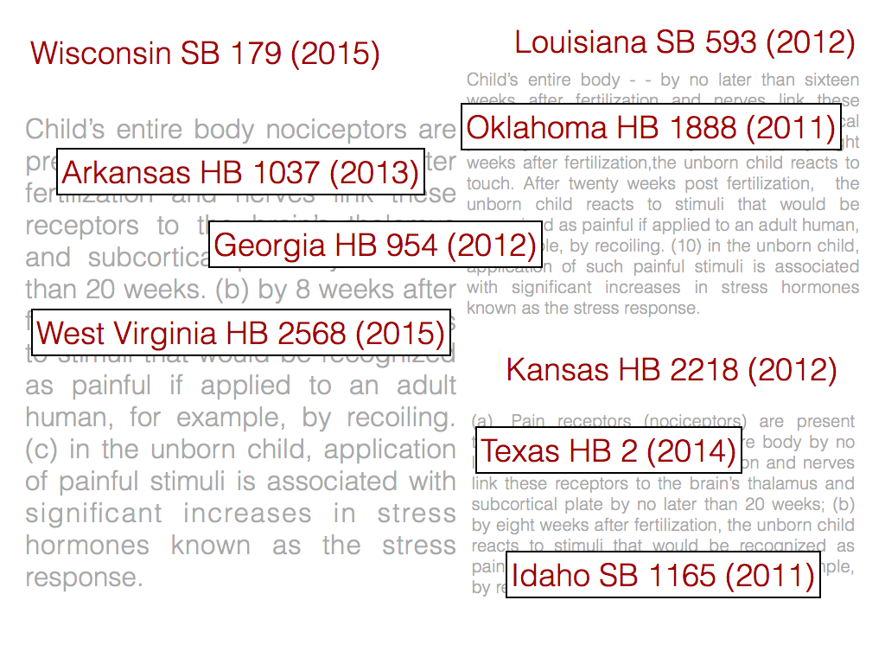

Slide 18
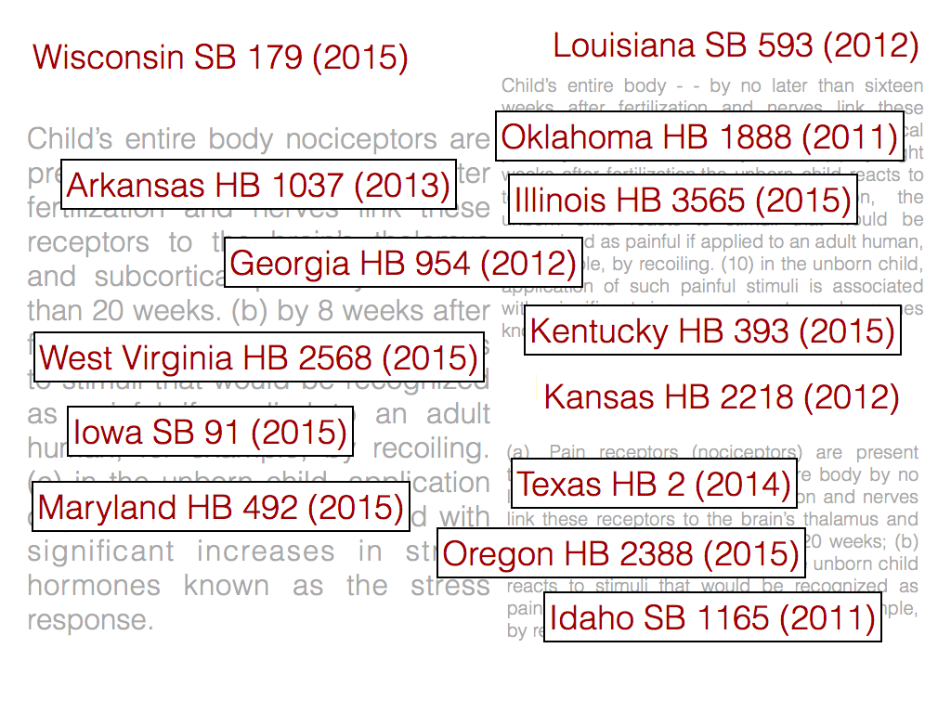

Slide 19
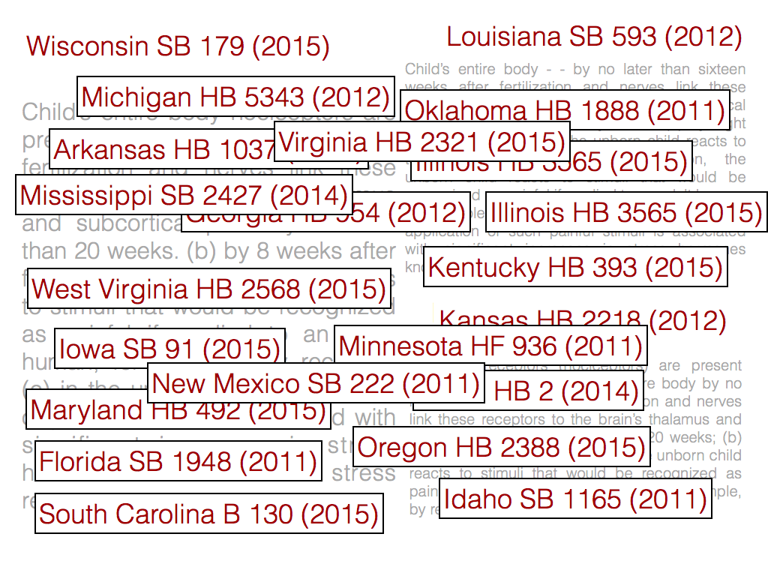
Notes:
In a matter of minutes, we found that there were 41 bills that shared a significant amount of text with the Wisconsin bill.
Because LID is a real-time system, it enables users to answer questions that previously would have required months if not years of manually reading documents. This summer we decide to use LID to examine the influence of interest groups on state politics. It is already well-known that interest groups have success in writing legislation and lobbying for it in states. But, how much success?

Slide 20
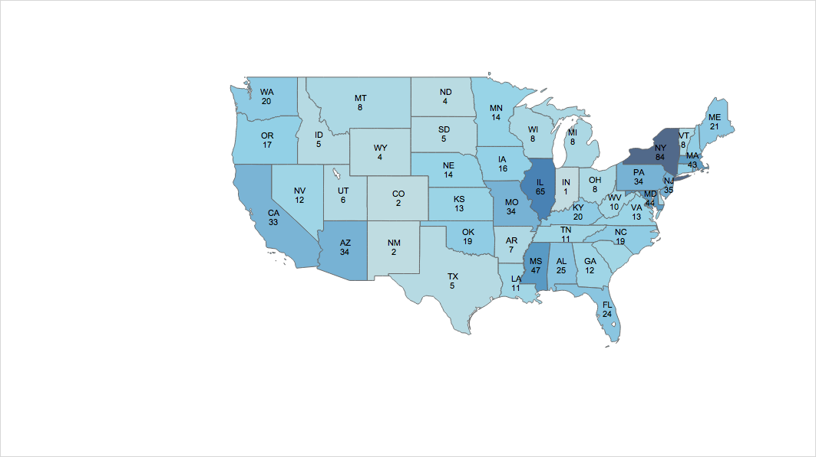
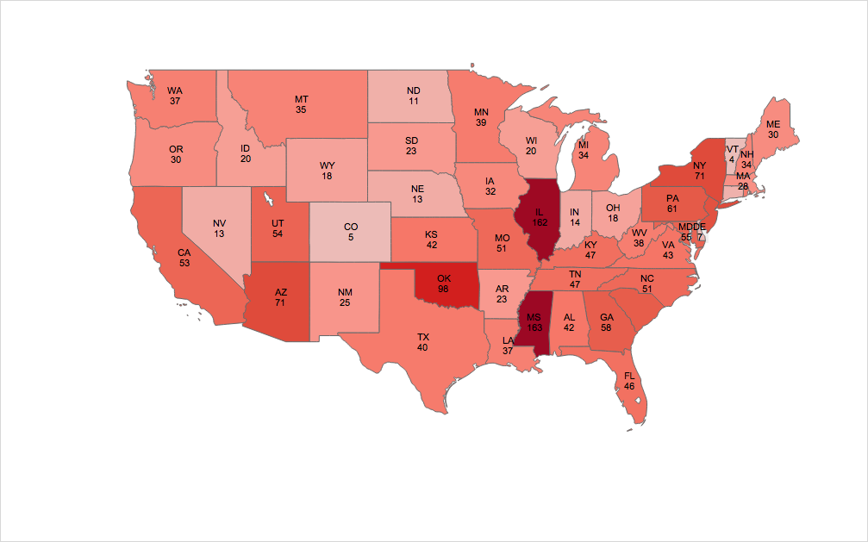
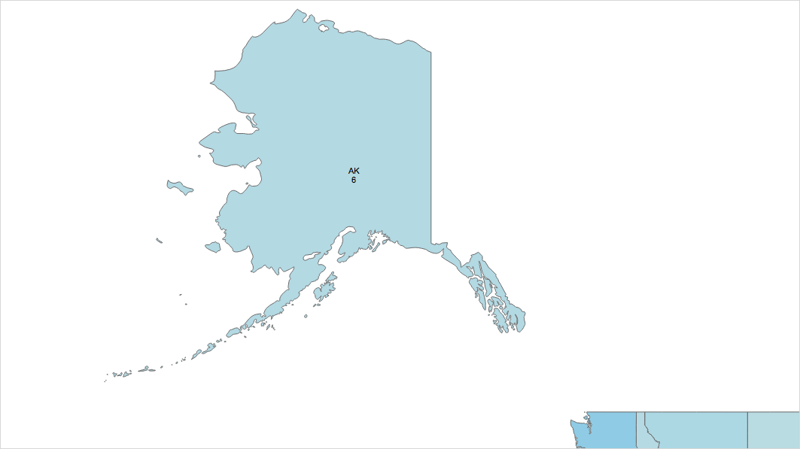
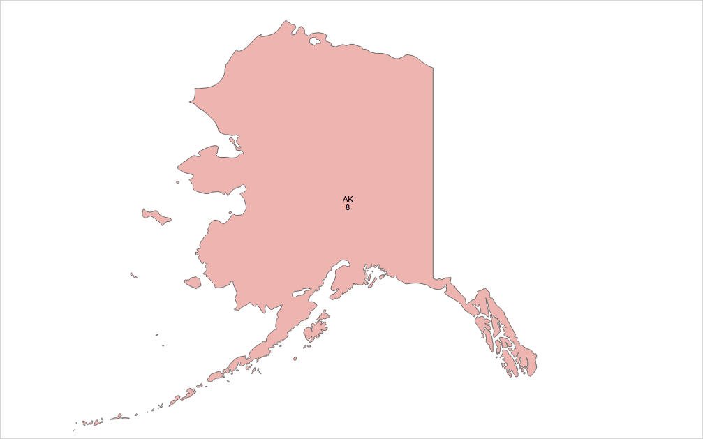

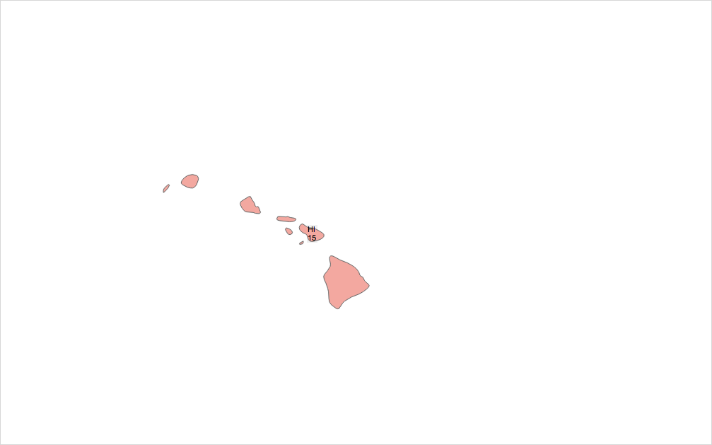
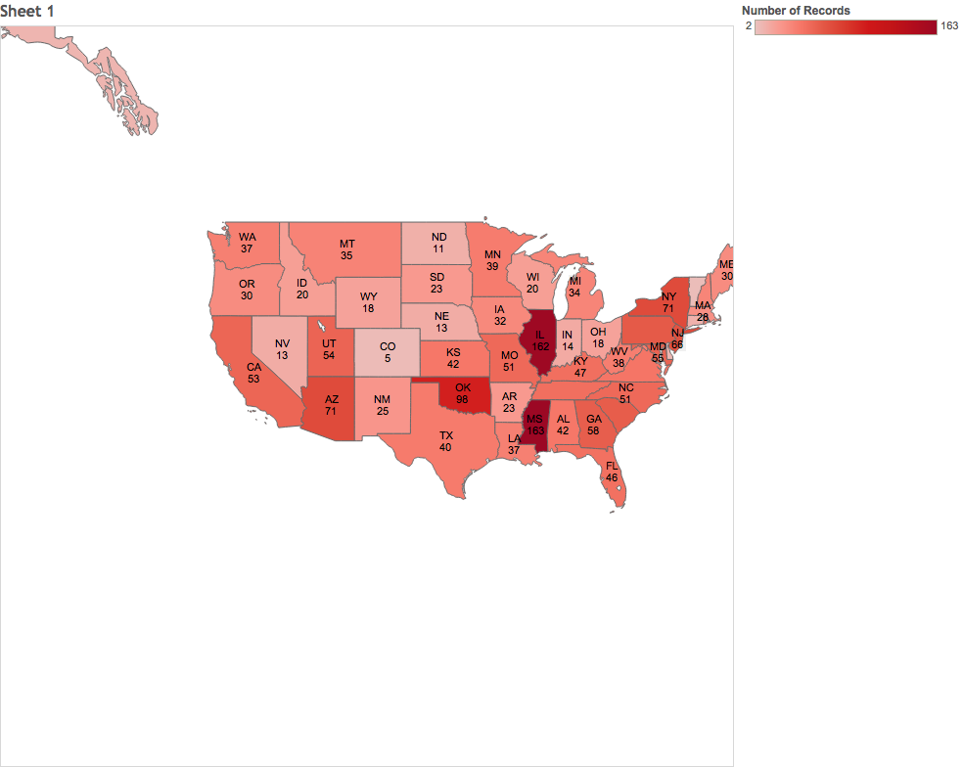
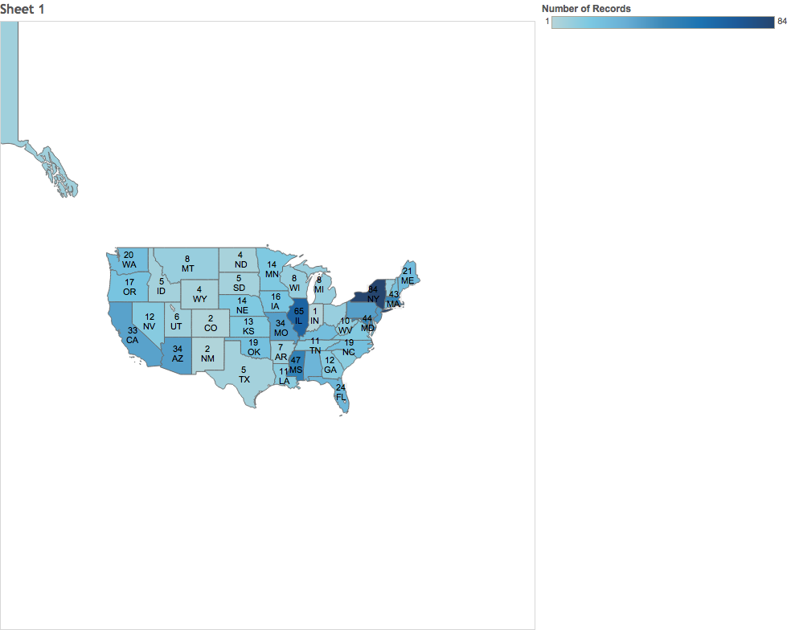
Number of Introduced Bills drafted by ALICE 2010-2015
Number of Introduced Bills drafted by ALEC 2010-2015
Number of Bills
Number of Bills
1
84
2
163
Total: 960
Total: 1816
Notes:
We collected 1000s of model bills from the websites of ALICE (a liberal group) and ALEC (a conservative group). Using LID, we were able to determine how much success these groups have had in each state in the past 5 years. We found that ALICE had introduced 960 bills and passed 84 and that ALEC had introduced 1816 and passed 163.
As this analysis shows, LID will enables researchers, journalists, and concerned citizens to better understand where bills come from. We believe that LID has the capacity to help increase transparency of state level politics, helping journalists and citizens to keep government accountable.
segue in:
for a given query, LID is capable of finding similar bills with shared text in a matter of seconds on our corpus of more than 500,000 state bills. The real-time nature of our tool enables users to conduct large scale analysis that if done by hand (even with the aid of google) would take months and lots of tedious work. For example, this summer we wanted to understand...

Slide 21
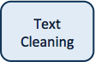
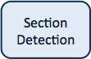

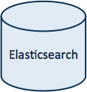
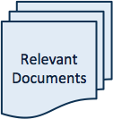
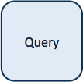
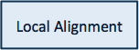

Pipeline

Slide 22
Indexing Bills
the federal
federal land
(A) the federal land manager of each such area shall develop a plan for evaluating visibility
land manager
ElasticSearch
the federal land
federal land manager
the federal land manager
federal land manager of

Slide 23
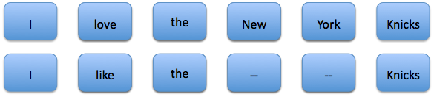
Definition of Alignment
“I love the New York Knicks”
“I like the Knicks”
Notes:
maybe need transition

Slide 24
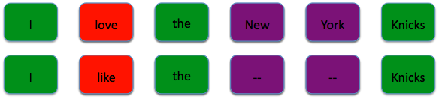
An Optimal Alignment
Scoring of alignment:
match score
mismatch score
gap score
Goal:
given two texts, find the alignment of two subsequences that has the optimal score.

Slide 25
Example
 | 0 | I | like | the | Knicks
0 | 0 | 0 | 0 | 0 | 0
I | 0 | ?
love | 0
the | 0
New | 0
York | 0
Knicks | 0
This is my example text
Match Score: 2
Mismatch Score: -2
Gap score: -.5
This is an an example of text matching
Notes:
cahnge the sequence below as you describe it

Slide 26

Example
 | 0 | I | like | the | Knicks
0 | 0 | 0 | 0 | 0 | 0
I | 0 | 2
love | 0
the | 0
New | 0
York | 0
Knicks | 0
Match Score: 2
Mismatch Score: -2
Gap score: -.5
This is my example text
This is an an example of text matching
Notes:
change the sequence below as you describe it

Slide 27
Example
 | 0 | I | like | the | Knicks
0 | 0 | 0 | 0 | 0 | 0
I | 0 | 2 | ?
love | 0
the | 0
New | 0
York | 0
Knicks | 0
Match Score: 2
Mismatch Score: -2
Gap score: -.5
This is my example text
This is an an example of text matching
Notes:
cahnge the sequence below as you describe it

Slide 28
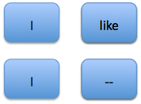
Example
 | 0 | I | like | the | Knicks
0 | 0 | 0 | 0 | 0 | 0
I | 0 | 2 | 1.5
love | 0
the | 0
New | 0
York | 0
Knicks | 0
Match Score: 2
Mismatch Score: -2
Gap score: -.5
This is my example text
This is an an example of text matching
Notes:
cahnge the sequence below as you describe it

Slide 29
Example
 | 0 | I | like | the | Knicks
0 | 0 | 0 | 0 | 0 | 0
I | 0 | 2 | 1.5 | ?
love | 0
the | 0
New | 0
York | 0
Knicks | 0
Match Score: 2
Mismatch Score: -2
Gap score: -.5
This is my example text
This is an an example of text matching
Notes:
cahnge the sequence below as you describe it

Slide 30
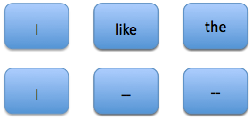
Example
 | 0 | I | like | the | Knicks
0 | 0 | 0 | 0 | 0 | 0
I | 0 | 2 | 1.5 | 1
love | 0
the | 0
New | 0
York | 0
Knicks | 0
Match Score: 2
Mismatch Score: -2
Gap score: -.5
This is my example text
This is an an example of text matching
Notes:
cahnge the sequence below as you describe it

Slide 31
Example
 | 0 | I | like | the | Knicks
0 | 0 | 0 | 0 | 0 | 0
I | 0 | 2 | 1.5 | 1 | 0.5
love | 0 | 1.5 | 1 | 0.5 | 0
the | 0 | 1 | 0.5 | 3 | 2.5
New | 0 | 0.5 | 0 | 2.5 | 2
York | 0 | 0 | 0 | 2 | 1.5
Knicks | 0 | 0 | 0 | 1.5 | 4
Match Score: 2
Mismatch Score: -2
Gap score: -.5
This is my example text
This is an an example of text matching
Notes:
cahnge the sequence below as you describe it

Slide 32
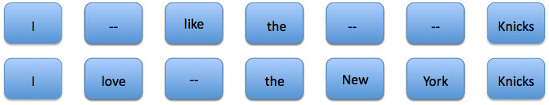
Example
 | 0 | I | like | the | Knicks
0 | 0 | 0 | 0 | 0 | 0
I | 0 | 2 | 1.5 | 1 | 0.5
love | 0 | 1.5 | 1 | 0.5 | 0
the | 0 | 1 | 0.5 | 3 | 2.5
New | 0 | 0.5 | 0 | 2.5 | 2
York | 0 | 0 | 0 | 2 | 1.5
Knicks | 0 | 0 | 0 | 1.5 | 4
Match Score: 2
Mismatch Score: -2
Gap score: -.5
This is my example text
This is an an example of text matching
Notes:
cahnge the sequence below as you describe it

Slide 33
Is LID useful for Social Science?
a new tool for measuring legislative influence
variable in a regression?
networks of legislators?
limitations

Slide 34
How can computer science help SS?
well known quantitative tools of SS:
econometrics
statistics
less well known quantitative tools of SS:
algorithms and machine learning

Slide 35
Advice for learning more
Online courses
Projects

Slide 36
Thank you

